Slide 1
Professional Development Series:
Transgender Students
& Their Collegiate Experiences
Jasmine Hattabaugh, Bekah Hickman, & Brooke Boyd
Arkansas Tech University
Spring 2016

Slide 2
Learning Objectives
After this presentation, the senior staff will understand:
  The challenges for transgender students in higher education
  Common perceptions of transgender people due to socialization
  Student development theories focused on transgender students
  Programs and services the Student Services professional development team suggests the University should implement

Slide 3

Defining “Transgender”
“The term transgender encompasses a wide range of identities, appearances, and behaviors that blur or cross gender lines. Within this transgender umbrella are transsexuals, who live some or all of the time in a sex different from their biological sex; cross-dressers (formerly called transvestites), who wear clothes typically associated with the “opposite” gender; drag kings and drag queens, who cross-dress within a performance context; and genderqueers, who identify outside of binary gender or sex systems” (Beemyn, 2005).
Notes:
“The term transgender encompasses a wide range of identities, appearances, and behaviors that blur or cross gender lines. Within this transgender umbrella are transsexuals, who live some or all of the time in a sex different from their biological sex; cross-dressers (formerly called transvestites), who wear clothes typically associated with the “opposite” gender; drag kings and drag queens, who cross-dress within a performance context; and genderqueers, who identify outside of binary gender or sex systems” (Beemyn, 2005).

Slide 4
Statistics
According to GLAAD, transgender Americans are becoming strong statistics.
90% of transgender people report experiencing harassment, mistreatment or discrimination.
41% of respondents reported attempting suicide, compared to 1.6% of the general population.
Transgender people are four times more likely to live in poverty.
72% of anti-LGBT homicide victims were transgender women.
90% of Americans say they personally know someone who is lesbian, gay, or bisexual.
Only 16% of Americans say they personally know someone who is transgender, which has doubled from the 8% who said so in 2008. 27% of millennials, 9% over 45 years” (Transgender FAQ, 2013).
90%
41%
72%
90%
16%
8%
27%
9%
Notes:
“90% of transgender people report experiencing harassment, mistreatment or discrimination…”
“41% of respondents reported attempting suicide, compared to 1.6% of the general population”
“Transgender people are four times more likely to live in poverty”
“72% of anti-LGBT homicide victims were transgender women”
“90% of Americans say they personally know someone who is lesbian, gay, or bisexual”
“Only 16% of Americans say they personally know someone who is transgender, which has doubled from the 8% who said so in 2008. 27% of millenials, 9% over 45 years”

Slide 5
A Personal Perspective About Life Identifying as Transgender
https://www.ted.com/talks/lee_mokobe_a_powerful_poem_about_what_it_feels_like_to_be_transgender#t-237771
Notes:
https://www.ted.com/talks/lee_mokobe_a_powerful_poem_about_what_it_feels_like_to_be_transgender#t-237771

Slide 6
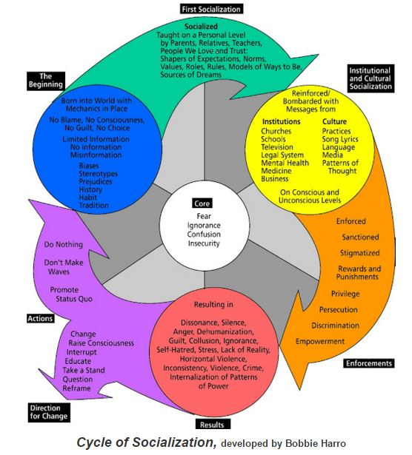
Cycle of Socialization

Slide 7
D’Augelli’s Transgender Identity Development Theory
Existing traditionally gendered identity
Developing personal transgender identity
Developing transgender social identity
Becoming transgender offspring
Developing transgender intimacy status
Entering transgender community (Evans, Forney, & Guidio-DiBrito, 1998)

Slide 8
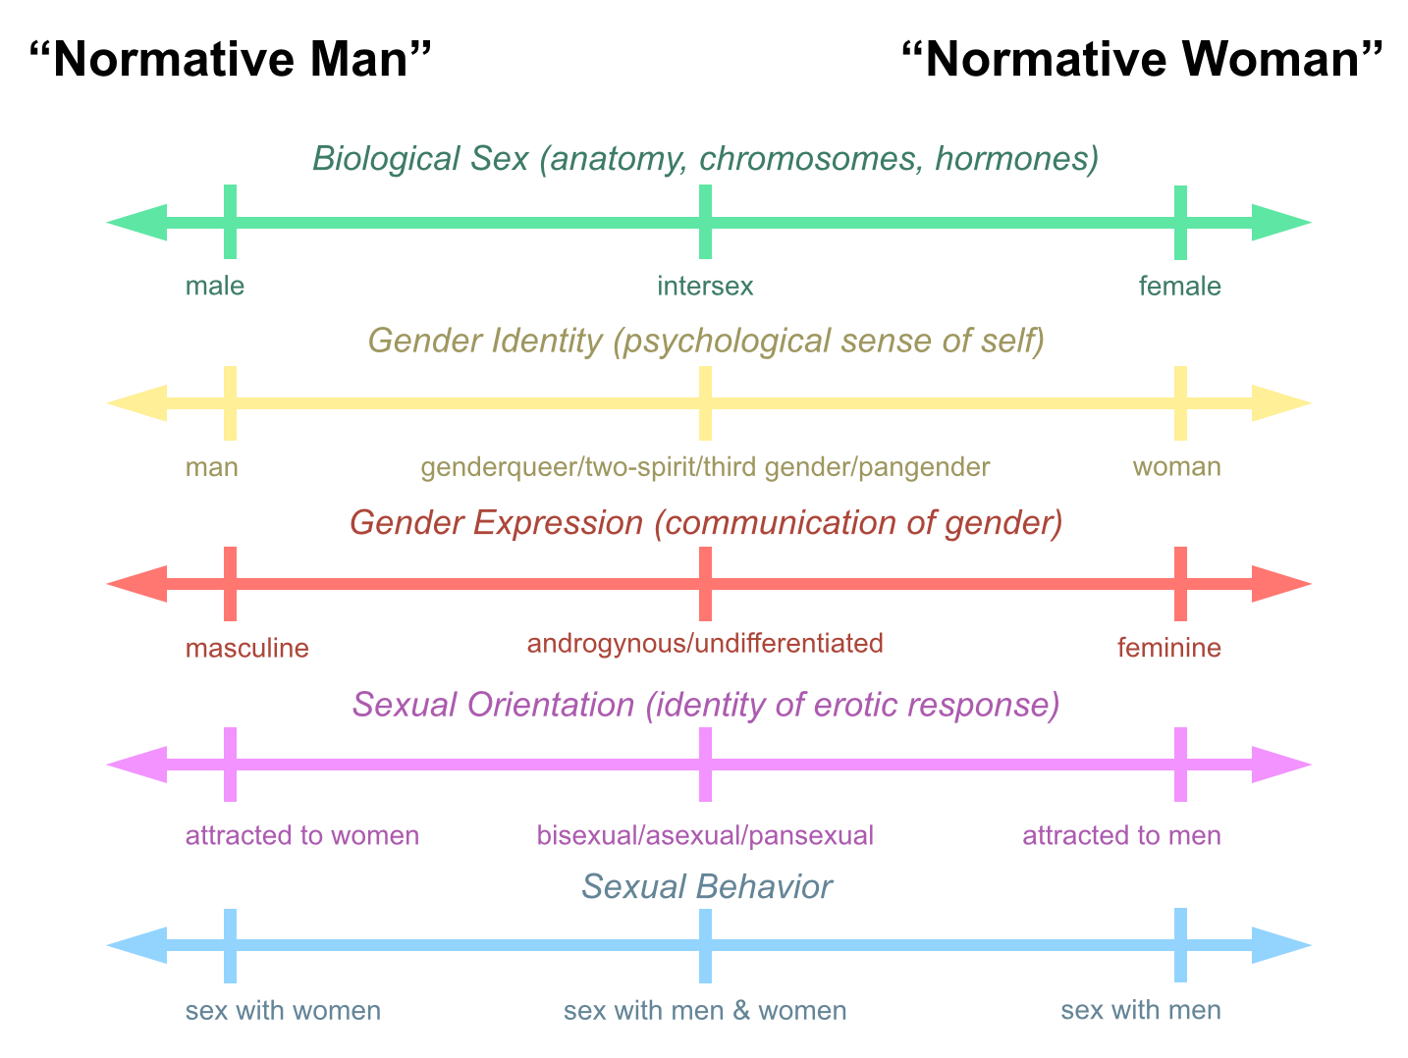
Diagram of Sex, Gender, & Sexuality (Center for Gender Sanity, 2009)

Slide 9
Emotional Stressors
Struggle between gender feelings and societal messages
Self doubt
Feelings of inadequacy due to homophobia
Inability to develop socially due to belief of negative stereotypes
Alienation and loneliness
Inability to cope with prejudices due to inability to learn from parents
Difficulty finding supportive relationships

Slide 10
Identifying the Problem
The situations and locations in which discrimination for transgender students are most likely to take place:
Campus programming
On-campus facilities, like residence halls, locker rooms, and bathrooms
Counseling and health care services
Correct identification and other policies related to gender identification

Slide 11
Programming
Here are some recommendations from Beemyn on how to improve campus programming:
Celebrate Transgender holidays
Create resource guides
Establish groups on campus
Make all events more inclusive
Train all members of our community

Slide 12
On-Campus Facilities
Provide residence hall accommodations that ensure safety and comfort
Create gender-neutral bathrooms and locker rooms.
Encourage all students to utilize these facilities.
Ensure the facilities are safe.
Provide proper education regarding facility usage.

Slide 13
Counseling & Healthcare Services
Train all staff
Gender Specialist counselors
Reach out to pharmacies near the university
Allow patients to use preferred names
Gynecological exams
Notes:
Trained counselors available, require all campus healthcare staff on transgender health, enable patients to identify their preferred name and identity on intake forms, make gynecological exams available outside of women’s health services, hire therapist who is trained gender specialist, have campus-affiliated pharmacies stock hormones and intramuscular syringes

Slide 14
Correct Identification & Other Policies
Identify those whom identify as transgender in both the Registrar’s Office and Human Resources.
Create one procedure for changing names and gender identifications on all institutional records.
Provide education to gender-based groups on campus.
Implement an anti-transgender bias campaign, which is included into the institution’s response system.
Adopt a campus diversity statement that includes the transgender community.

Slide 15
Action Plan
Administer survey to current University population to determine success of current programs, need for programming and perception of the transgender community.
Update current policies to best accommodate students and campus climate changes.
Provide training to all members of our University community on transgender students and their needs.
Implement the aforementioned programs and services for our student body.
Administer the same survey once a year for five consecutive years, to gather information on how said changes are being perceived and utilized.

Slide 16
References
Beemyn, B., Curtis, B., Davis, M., & Tubbs, N. J. (2005). Transgender issues on college campuses. New Directions for Student Services, 2005(111), 49-60. http://vp.studentlife.uiowa.edu/assets/Transgender-Issues-on-College-Campuses.pdf
Beemyn, B. G. (2005). Making campuses more inclusive of transgender students. Journal of Gay and Lesbian Issues in Education, 3(1), 77-87. https://libcatalog.atu.edu:443/login?url=http://search.ebscohost.com/login.aspx?direct=true&db=a9h&AN=19565460&site=ehost-live&scope=site
Bilodeau, B. L. & Renn, K. A. (2005). Analysis of LGBT identity development models and implications for practice. New Directions for Student Services, 111, 25-39. https://msu.edu/renn/BilodeauRennNDSS.pdf
Center for Gender Sanity. (2009). Diagram of sex and gender. Retrieved from http://www.gendersanity.com/diagram.html
Evans, N. J., Foreny, D. S., & Guido-DiBrito, F. (1998). Student development in college: Theory, research, and practice (pp. 96-98).
Seelman, K. L. (2014). Recommendations of transgender students, staff, and faculty in the USA for improving college campuses. Gender & Education, 26(6), 618-635. doi: 10.1080/09540253.2014.935300
Transgender FAQ. (2013). Retrieved February 24, 2016, from http://www.glaad.org/transgender/transfaq
Wollenshleger, M. (2013). Gender and sexuality development theories. Student Development Theories. https://studentdevelopmenttheory.wordpress.com/gender-and-sexuality/
Zubernis, L. & Snyder, M. (2007). Considerations of additional stressors and developmental issues for gay, lesbian, bisexual, and transgender college students. Journal of College Student Psychotherapy, 22(1), 75-79. doi: 10.1300/J035v22n0106

